Slide 1
Project 1⏐Does College Education provide a higher quality of Life within the US?
SMU Data Science Bootcamp Group 5

Slide 2
Contents
Introduction: Hypothesis & Objectives
Methodology
Results
Conclusions

Slide 3
1. Introduction > Hypothesis & Objectives
Hypothesis
College Education Attainment has an impact on Quality of Life.
An estimated 20 million students attended the 5,300 colleges in the United States in 2018(source?). With these figures constantly growing, questions have arose as to the pertinence and quality of college courses.
Through this study, we intend examine and test the importance of College Education and it’s impact on Quality of Life.
Objectives
This piece will strive to gather and cross-analyze the following metrics:
High School and College Attainment per state;
Quality of Life (QoL) indices per state:
Material Wellbeing (GDP per person );
Health (Life Expectancy);
Family Life (Divorce rate);
Community Life (Religiosity / Church Attendance);
Climate and Geography (Latitude, to distinguish between warmer and colder climates);
Job security (unemployment rate);
Gender Equality (ratio of average male and female earnings)
Political Freedom (standard across all states)
Political Stability (standard across all states)

Slide 4
Contents
Introduction: Hypothesis & Objectives
Methodology
Results
Conclusions

Slide 5
2. Methodology
Our approach is made up of several logical steps using tools and methods to analyse…???
1
Defining Quality of Life and Education Attainment
Quality of Life can be defined as the standard of health, comfort and happiness experienced by an individual or a group. It’s numerous indices can be grouped by the following factors : Economic, Community and Environmental.
Education Attainment : The highest level of education an individual has completed.
2
Using databanks to gather key metrics
A variety of governmental and private databanks were used to gather raw datasets. These were then compared, cleansed and analysed for potential anomalies.
The Economist: Quality of Life
US Census: Population
Kaggle: GDP per State
The Health Inequality Project: Life Expectancy
Center for Disease Control: Divorce Rate
Human Development Report: Gender Equality
Etc.

Slide 6
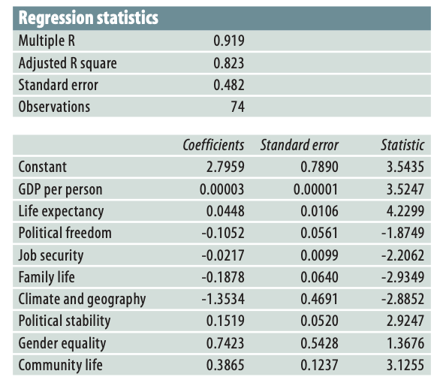
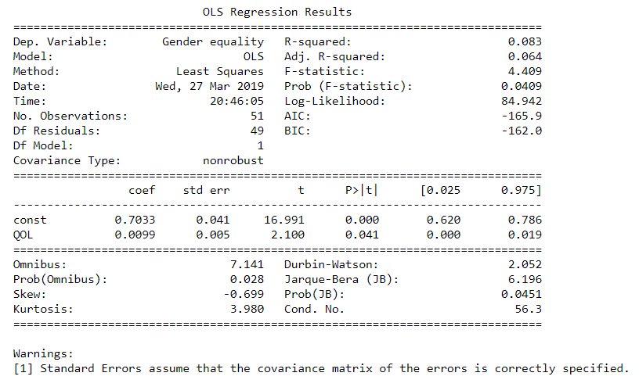
2. Methodology (cont.)
3
Quality of Life coefficients
We rely on the expertise of the United Nations and Economist research for these coefficients.
4
Regression Analysis
Upon determining each state’s Quality of Life index, regression analysis were performed to examine the influence of one or more independent variables on other dependent variables.

Slide 7
Contents
Introduction: Context & Objectives
Methodology
Results
Conclusions

Slide 8

3. Results > QoL Correlations
What is the heatmap showing???
Heatmap exhibiting correlation between indices
n(Total) = 50 States;
This scale seems to be weighted toward the negative, but that is the result of the mathematical relationships between the variables and not intentional selection.
Important: climate is defined by latitude in the analysis. Therefore as latitude increases (heads northward), QOL decreases.

Slide 9
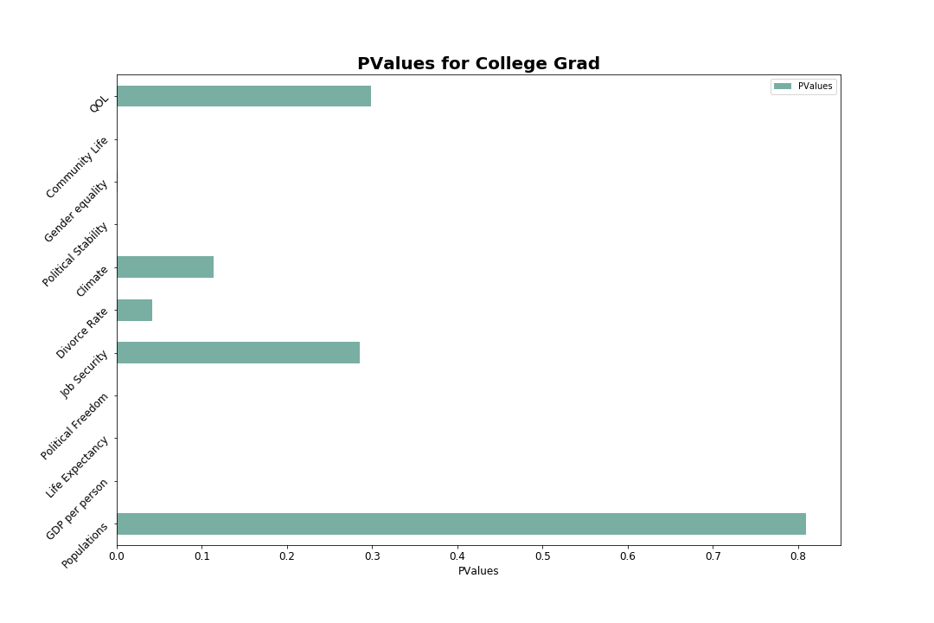
3. Results > Summary
Results summary
College education levels do not predict quality of life

Slide 10
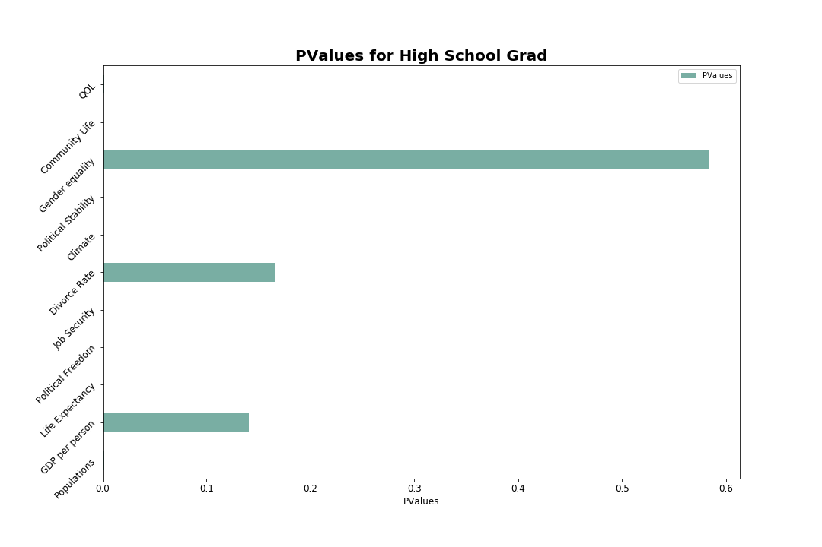
3. Results > Summary
Results summary
High School education levels DO correlate to higher quality of life
There is a degree of subjectivity in defining quality of life
The QOL equation may not reflect a given individual’s value system

Slide 11
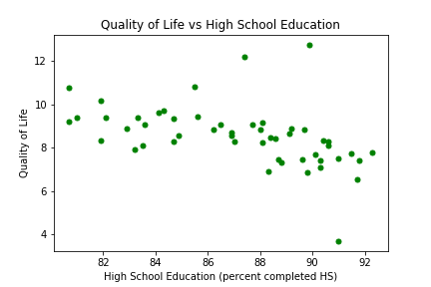
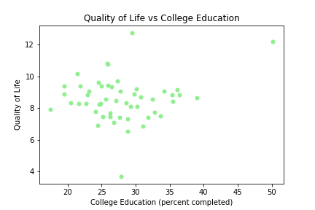
3. Results > Summary
Results summary

Slide 12
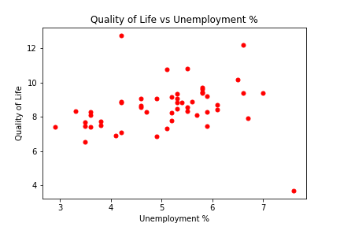
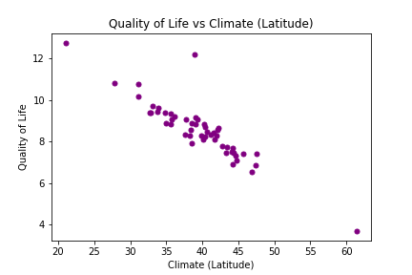
3. Results > Summary
Results summary

Slide 13
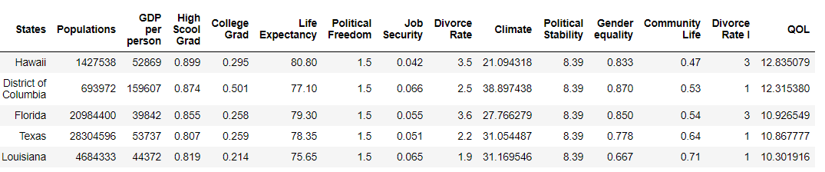
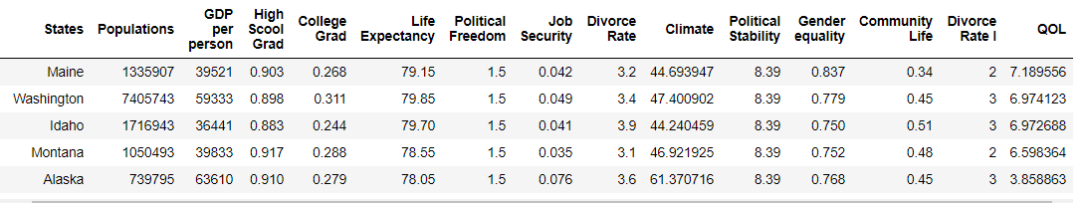
Head vs Tail
Top 5 States vs QOL
Bottom 5 States vs QOL

Slide 14
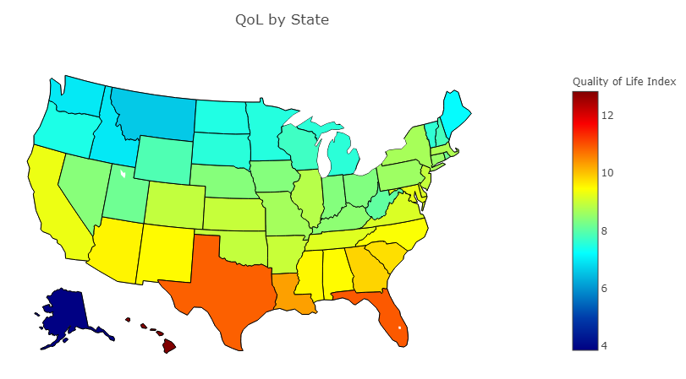
3. Results > Quality of Life per State
The heatmap shows that quality of life strongly correlates to southern climates,
Heatmap showing Quality of Life per State
n(Total) = 50 States;
If you want higher quality of life, move south and don’t go to college.

Slide 15
Contents
Introduction: Context & Objectives
Methodology
Results
Conclusions

Slide 16

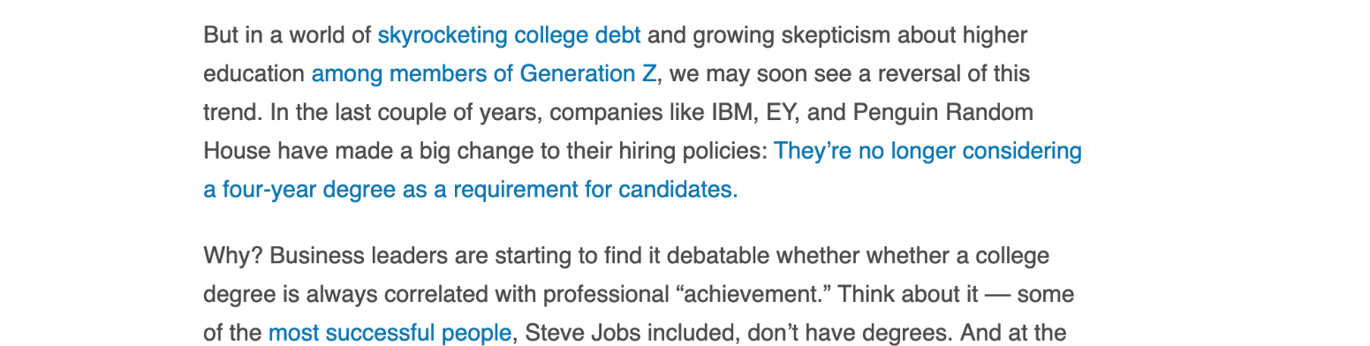
4. Conclusions > Interesting facts
Professional programs offered by Colleges in likes of SMU Data Science bootcamp have showed their pertinence in the past couple of years and companies are increasingly considering such programs as a substitutes to 4-year degree requirements.
Facts
29.9% of billionaires around the world do not have a Bachelor’s Degree. This excludes honorary degrees, masters and PhD imputed to billionaires by colleges due to their exceptional achievements and contributions to their respective fields.
[Billionaire Census by Wealth X - 2016]
Our data suggest the existence of a positive correlation between QoL and financial prosperity. Howbeit, financial success doesn’t guarantee a high level of quality of life. This is made evident by the increasing suicide incidents observed in richer communities.
Guess, we’re sowing into good ground after all !

Slide 17
5. Questions and Answers
5. Questions and Answers
Questions & Answers

